Slide 1
Web Development 3
Web Introduction
Ashley Cahill
ashley.cahill@tus.ie

Slide 2
Learning Outcomes
History of the Internet and World Wide Web.
Identify types of websites.
Describe architecture of Web Apps.
Describe Web 2.0.
Describe Rich Internet Applications (RIA’s).
Describe Web 2.0 technologies.
Describe Web 3.0 technologies
Installations

Slide 3
History of The Internet
1962 MIT computer scientist J.C.R. Licklider develops an idea for a global computer network.
Collaboration with U.S. Department of Defense Advanced Research Projects Agency (ARPA).
U.S DoD implemented a network of computer systems (ARPANET) of about a dozen ARPA funded universities and research institutions.

Slide 4
History of The Internet, 1970’s
1973, The TCP/IP communications protocols were developed for the ARPANET by computer scientists Robert Kahn and Vint Cerf.
ARPA developed the TCP and IP protocols and the ARPANET evolved into today’s Internet

Slide 5
History of The Internet, 1980’s
1982, Dave Farber of the University of Delaware builds a network of dial-up phone lines – PhoneNet.
PhoneNet is connected to ARPANET and the first commercial network, Telenet.
3Com announces Ethernet products for both computer workstations and personal computers; this allows for the establishment of local area networks (LANs).

Slide 6
History of The Internet, 1980’s (contd.)
Paul Mockapetris, Jon Postel and Craig Partridge create the Domain Name System, which uses domain names to manage the increasing number of users on the internet.
1985, the first domain is registered: symbolics.com

Slide 7
History of The Internet, 1990’s
1990, Tim Berners-Lee of CERN (the European Organization for nuclear Research) began to develop a technology for sharing information via hyperlinked text documents.
HyperText Markup Language (HTML) was born.
Berners-Lee also wrote the Hypertext Transfer Protocol (HTTP) and Uniform Resource Locator (URL)

Slide 8
History of The Internet, 1990’s (contd.)
ARPANET is decommissioned
The first incarnation of the World Wide Web is born!
1993, the Mosaic browser is released.
The team that developed Mosaic, went on to found Netscape.

Slide 9
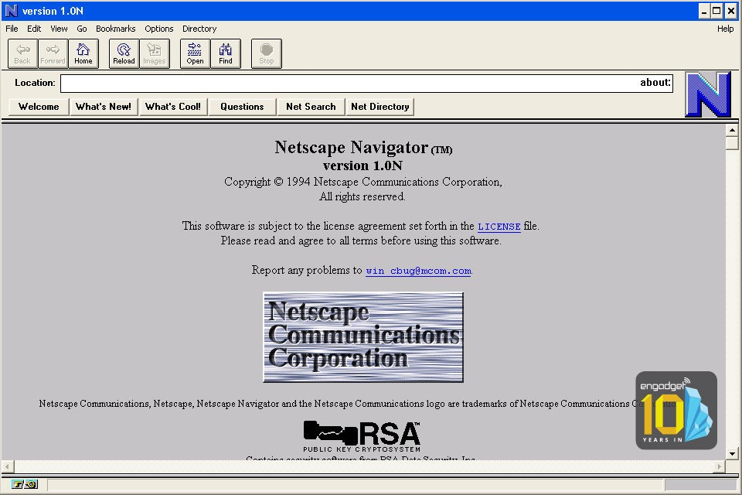
History of The Internet, Netscape
The team that developed Mosaic, went on to found Netscape.

Slide 10
History of The Internet, W3C
In October 1994, Tim Berners-Lee founded an organization – called the World Wide Web consortium (W3C).
W3C’s primary goal is to make the web universally accessible.
W3C is now a standards organization.
Web technologies standardised by the W3C are called “Recommendations”.

Slide 11
History of The Internet, W3C (contd.)
W3C recommendations include
XHTML
CSS
HTML (now considered legacy)
XML
HTML5
PNG (Portable Network Graphic)
Reference www.w3.org

Slide 12
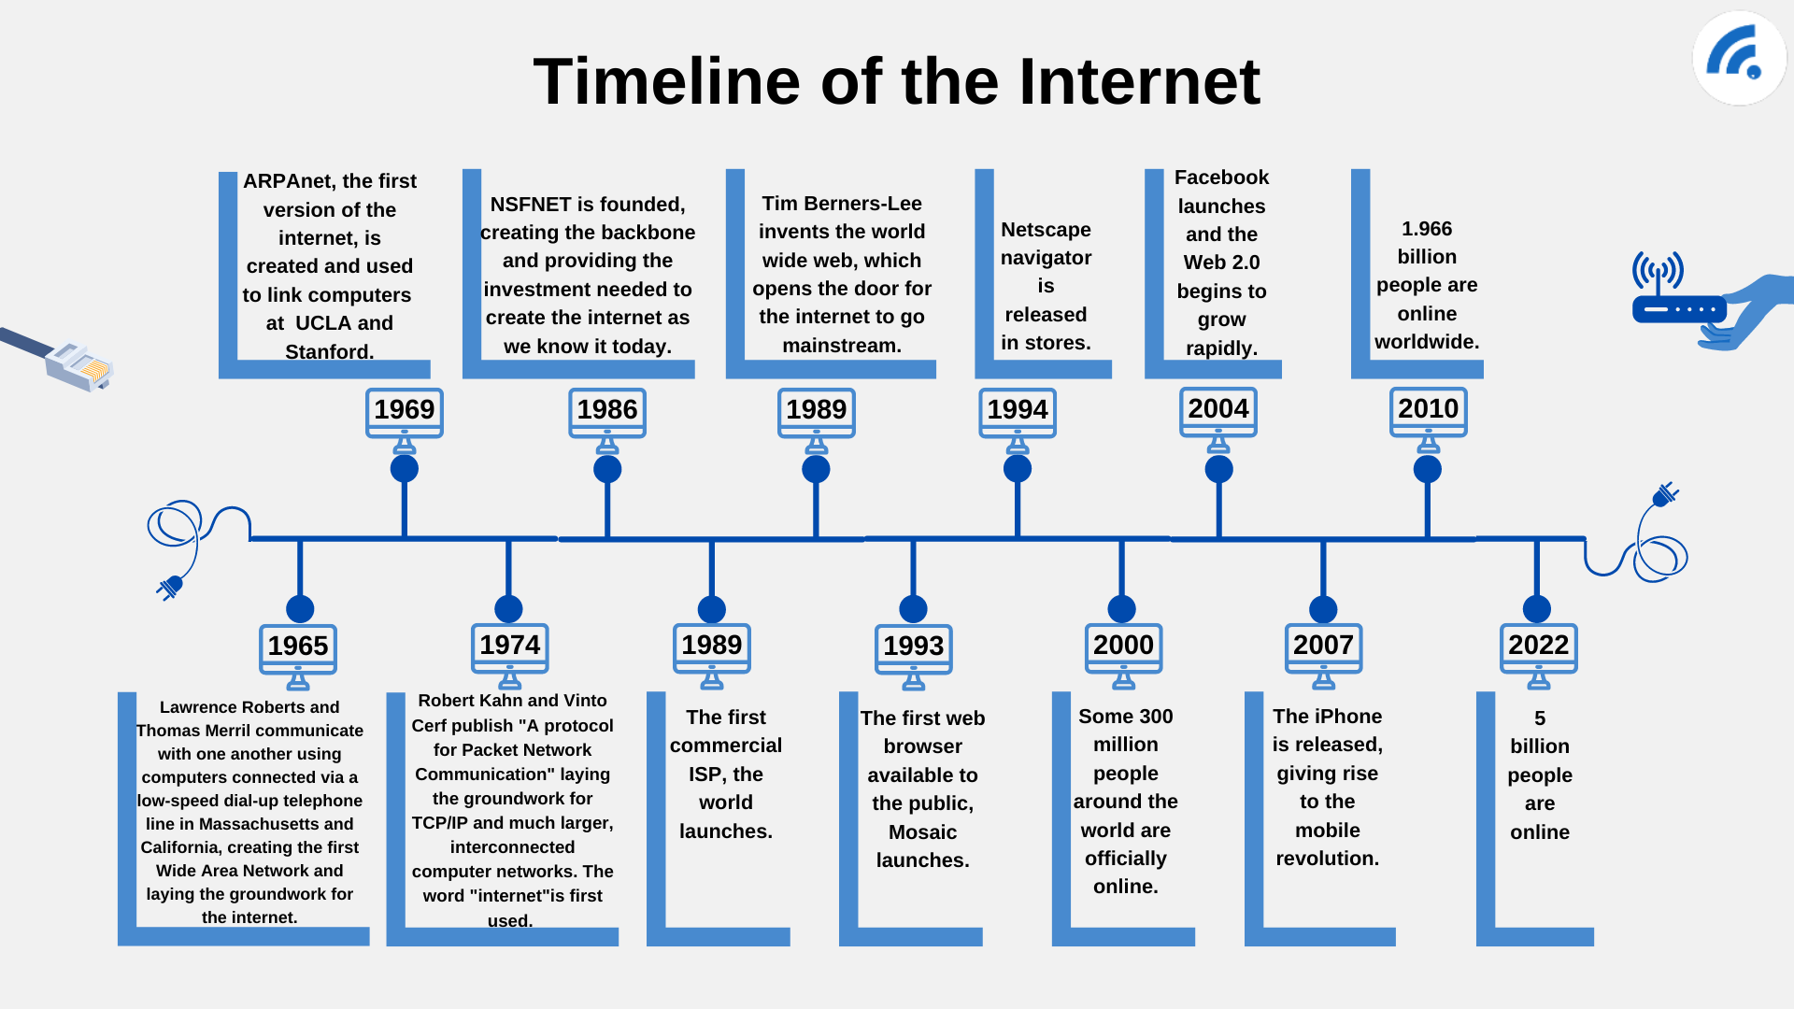
History of The Internet, Timeline
Recap
https://www.broadbandsearch.net/blog/who-invented-the-internet-full-history
https://www.broadbandsearch.net/blog/who-invented-the-internet-full-history

Slide 13
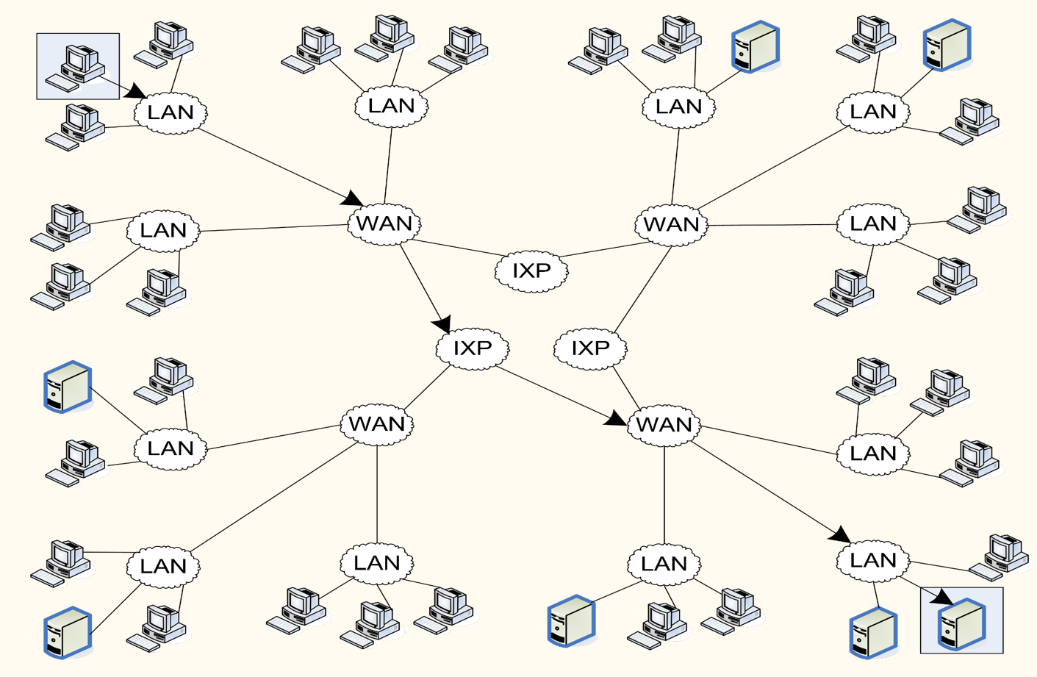
Architecture of The Internet
LAN – Local Area Network
IXP – Internet Exchange Point
WAN – Wide Area Network

Slide 14
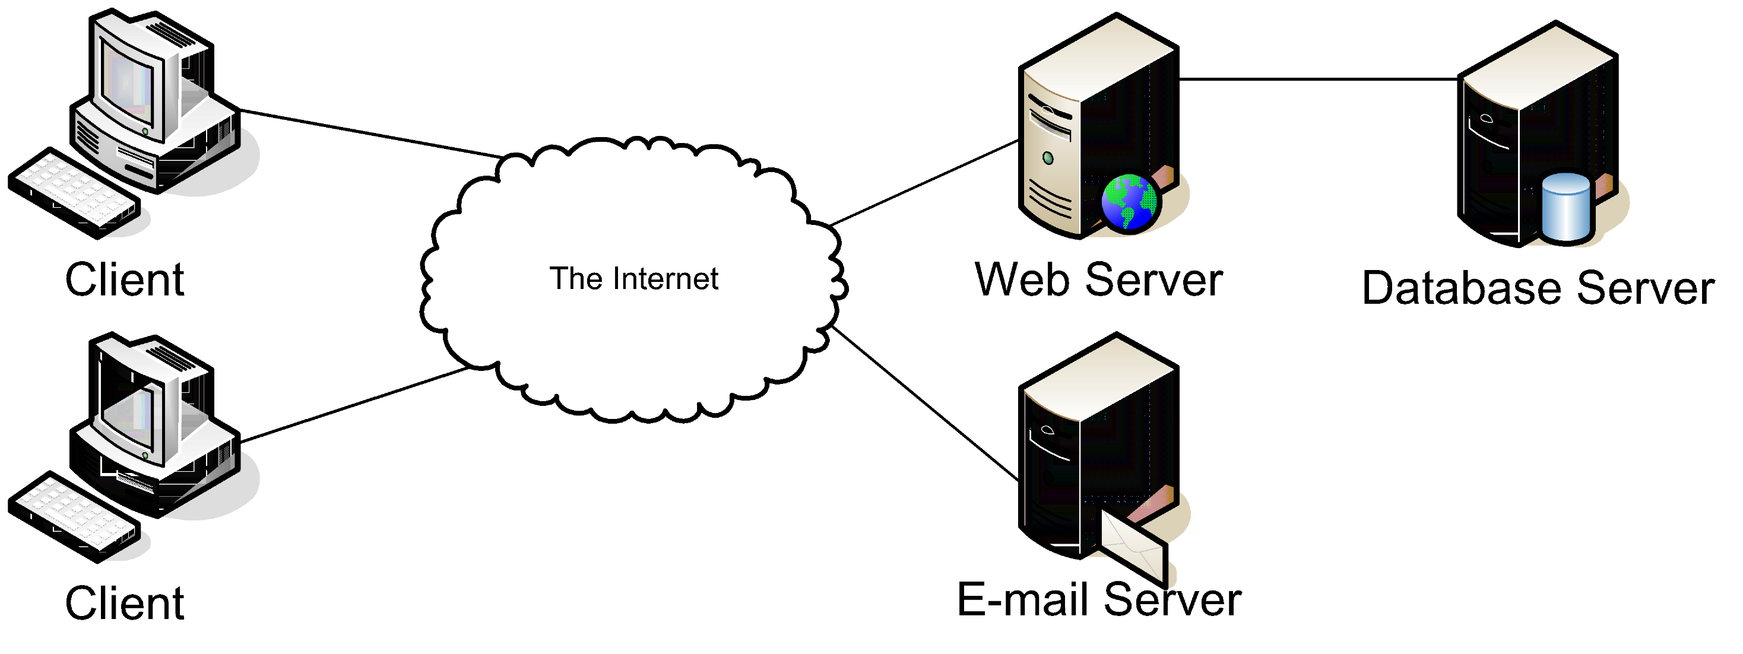
Architecture of (typical) Web Application
Client Tier Server Tier Database Tier

Slide 15
Processing a Static Web Page
Web pages depend on 2 protocols
HyperText Transfer Protocol (HTTP).
Transmission Control Protocol/Internet Protocol (TCP/IP).
Terms
Hyper-Text Markup Language (HTML)
Static Web Page
Dynamic Web Page
HTTP Request
HTTP Response

Slide 16














Processing a Static Web Page
HTTP request
XHTML
file
HTTP response
Web browser
Web server

Slide 17
HTTP Request/Response
A simple HTTP request
GET / HTTP/1.1
Host: www.example.com
A simple HTTP response
HTTP/1.1 200 OK
Content-Type: text/html
Content-Length: 136 Server: Apache/2.2.3
<html>
<head>
<title>Example Web Page</title>
</head>
<body>
<p>This is a sample web page</p>
</body>
</html>

Slide 18


















Processing a Dynamic Web Page
HTTP request
HTTP response
Web Browser
Web Server
Database Server
PHP
Script

Slide 19
Server Side Technologies
Server-side languages/technologies
PHP
JSP
ASP.NET
Perl
Python
Node.js
Groovy/Grails
Ruby on Rails

Slide 20
Database Technologies
Database Servers
MySQL
Oracle
DB2
MS SQL Server
MariaDB
Sybase
MongoDB

Slide 21
Web 1.0
Web 1.0; 1989 to early 2000’s.
Focus on small number of companies and advertisers.
Static.
Minimal interaction between User and Server.
Known as “Read-Only Web”.
Mostly a way for researchers to share scientific information.
Frames/Tables are used to position and align the elements on a page.

Slide 22
What is Web 2.0
In 2003 there was a noticeable shift in how people and business were using the web and developing web-based applications.
The term “Web 2.0” was coined by Darcy DiNucci in 1999,
Also claimed by Dale Dougherty 2003, ahead of the Web 2.0 summit
O’ Reilly, T. “What is Web 2.0: Design Patterns and Business Models for the Next Generation of Software,” September 2005 http://www.oreillynet.com/pub/a/oreilly/tim/news/2005/09/30/what-is-web- 20.html?page=1

Slide 23
Web 2.0
Web 2.0; 2000’s to present day.
Companies use the web as a platform to create community based sites (e.g. social networking sites, blogs, wikis, etc.).
Dynamic.

Slide 24
Characteristics of Web 2.0
Web 2.0 is characterized by participation – a design that encourages user interaction and community contributions.
Many Web 2.0 companies are built almost entirely on user-generated content. E.g. Facebook, Twitter, YouTube, eBay, Wikipedia.

Slide 25
Characteristics of Web 2.0
Web Services allow you to incorporate functionality from existing applications and websites into your own web applications
e.g. Amazon Web Services (AWS).
Create “mash-up” applications using, for example Google Maps web services and eBay web services to find auction items in a certain geographical area.
Rich Internet Applications (RIAs) are being developed using technologies (such as AJAX) that have the look and feel of desktop software.

Slide 26
Web 3.0
Present day and into the future.
Use artificial intelligence and machine learning to create semi-autonomous agents.
IoT.

Slide 27
Features of Web 3.0
Decentralisation (Decentralised networks)
Trustless and Permissionless
3D Graphics
Artificial Intelligence and Machine Learning
Connectivity and Ubiquity (IOT)

Slide 28
Features of Web 3.0
Decentralisation (Decentralised networks)
In Web 2.0, computers use HTTP in the form of unique web addresses to find information, which is stored at a fixed location, generally on a single server. Web 3.0 information will be found based on its content, and thus can be stored in multiple locations simultaneously. It becomes decentralized

Slide 29
Features of Web 3.0
Trustless and Permissionless
As it is based upon open source software, Web 3.0 will also be trustless (i.e., the network will allow participants to interact directly without going through a trusted intermediary) and permissionless (meaning that anyone can participate without authorization from a governing body

Slide 30
Features of Web 3.0
Artificial Intelligence (AI) and Machine Learning
In Web 3.0, computers will be able to understand information similarly to humans, through technologies based upon Semantic Web concepts and natural language processing

Slide 31
Features of Web 3.0
Connectivity and Ubiquity
With Web 3.0, information and content will be more connected and ubiquitous (found everywhere.)
It will be accessed by multiple applications and with an increasing number of everyday devices connected to the web (IoT)

Slide 32
Rich Internet Applications
What are Rich Internet Applications (RIA’s)?
Web applications that have the functionality and features of traditional desktop applications.
Typically runs in a web browser (does not need any extra software installation).
Transfers the processing necessary for the user interface to the web client.

Slide 33
Benefits of RIA’s
Richer (Visual and User Experience).
Web applications that have the functionality and features of traditional desktop applications.
Typically runs in a web browser (does not need any extra software installation).
Transfers the processing necessary for the user interface to the web client.

Slide 34
RIA Technologies
Term “RIA” introduced by Macromedia (now Adobe).
Referred to applications created using their technology.
Widely used now also to refer to applications using other (non-Adobe technologies) such as Ajax.

Slide 35
RIA Technologies - AJAX
AJAX (Asynchronous JavaScript and XML), a term from Adaptive Path’s Jesse James Garret in February 2005.
AJAX allows partial page updates – meaning updates of individual pieces of a web page without having to reload the entire page.
Technologies include (HTML5, CSS, JavaScript, the DOM, XML/JSON, and XMLHttpRequest object).

Slide 36
Client/Server Role - RIA
Application sent from server to client as web page with embedded code.
Application running on client provides user with interactive interface.
Data and business logic on server.

Slide 37
Client/Server Role – RIA (contd.)
Data sent by server in response to client requests.
Client uses data to update interface.
Processing now on client side and on server.
User interaction based on hyperlinks, form input, GUI controls.

Slide 38
Web vs Desktop Applications
Web Applications
Run in a browser and do not require software installation.
Updates are transparent to the user.
User can access application from any computer.
Desktop Applications
Applications must be installed and maintained.
Rich user interface.

Slide 39
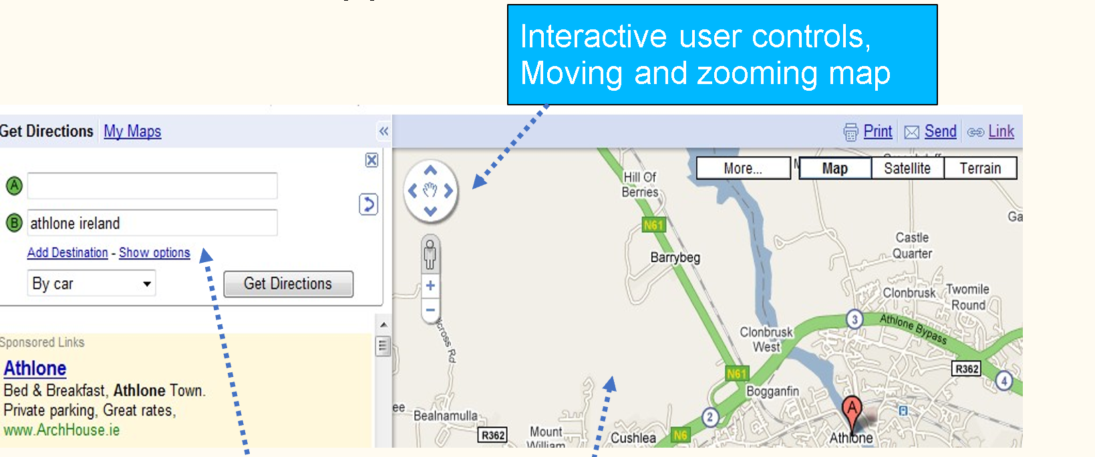
Typical Features of RIA’s
Interactive user controls, Moving and zooming map
.
Partial page updates and dynamic forms(multi-purpose
panel, input boxes added dynamically)
Data retrieved interactively
From server without refreshing entire page (new map data as map is moved)

Slide 40
Web Development 3
Lab (Intro)
Ashley Cahill
ashley.cahill@tus.ie

Slide 41
Learning Outcomes
Describe Webservers
Describe XAMPP
Install XAMPP
Install NetBeans
Install MySQL

Slide 42
Web Servers
A web server accepts and fulfils requests from clients for static content (i.e., HTML pages, files, images, and videos) from a website.
Web servers handle HTTP requests and responses only.

Slide 43
Application Servers
An application server exposes business logic to the clients, which generates dynamic content. It is a software framework that transforms data to provide the specialized functionality offered by a business, service, or application. (www.educative.io/answers/web-server-vs-application-server)

Slide 44
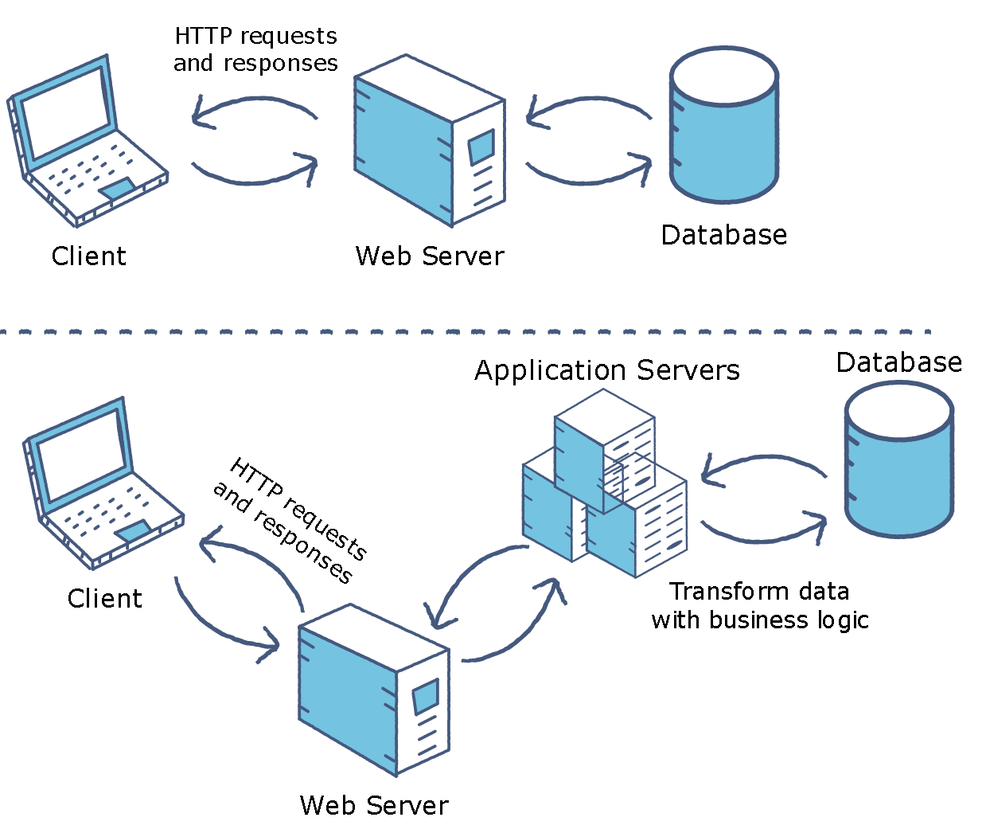
Web Servers vs Application Server

Slide 45
XAMPP
Developed in 2002.
XAMPP is an abbreviation for cross-platform, Apache, MySQL, PHP and Perl.
Free and open-source cross-platform web server solution stack package developed by Apache Friends.

Slide 46
XAMPP Installation
www.apachefriends.org/download.html
Executable installer.
Available for Windows, Linux and OS X download/installation.
Also available for direct install on Software Centre in Labs

Slide 47
NetBeans
NetBeans is an integrated development environment for Java, C++, HTML/JavaScript and PHP.
Free and open source.
Started as a student project at Charles University in Prague in 1996.

Slide 48
NetBeans
1999, bought by Sun Microsystems.
2000, Sun Microsystems acquired by Oracle.
2016, Oracle donated to Apache Software Foundation and rebranded as Apache NetBeans.

Slide 49
NetBeans Installation
https://netbeans.apache.org/download/index.html
Also available as direct install in labs via Software Centre

